Slide 1
Unit 11
How was your school trip?
Section A 2a-2d
七年级下册

Slide 2
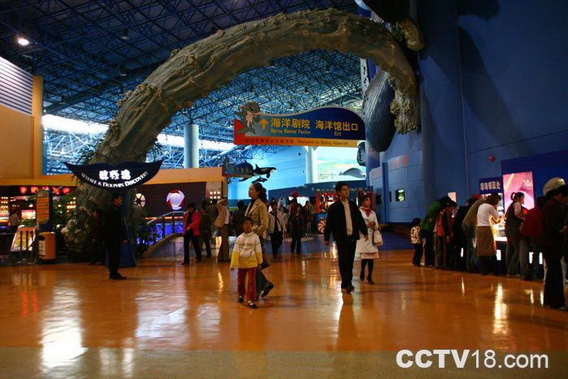
What did you do in your vacation?
went to the aquarium

Slide 3
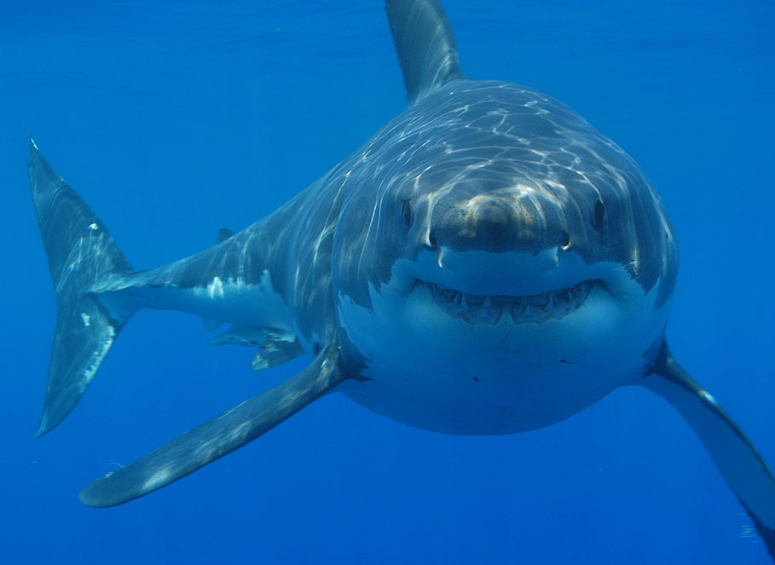
saw some sharks

Slide 4
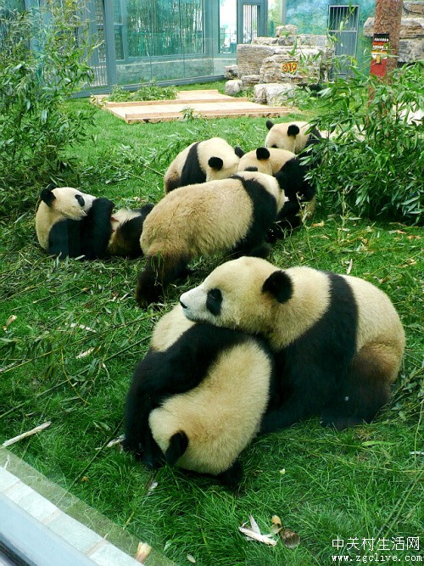
went to the zoo

Slide 5
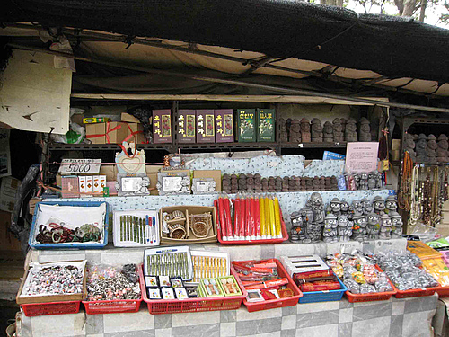
bought a souvenir

Slide 6
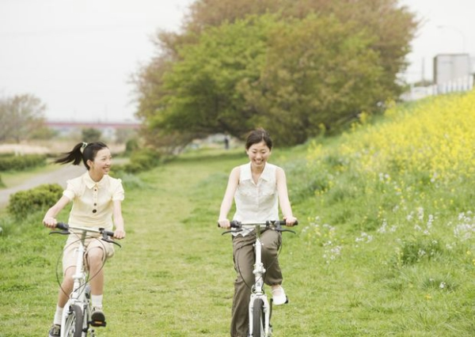
hung out with friends

Slide 7
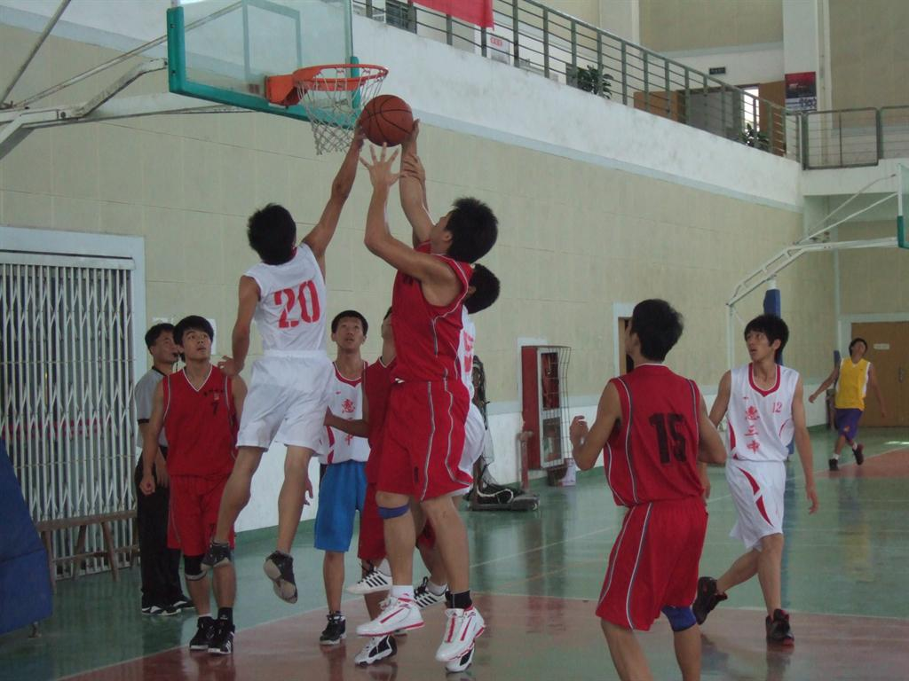
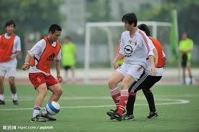
played basketball
played soccer

Slide 8
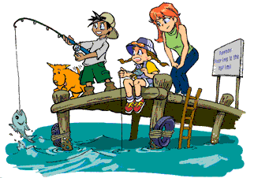
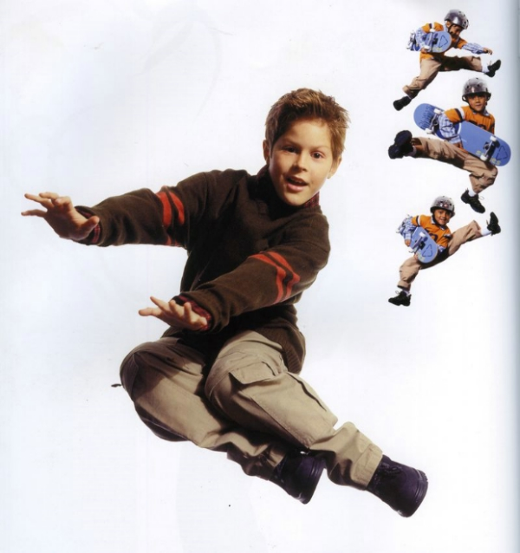
went fishing
went skateboarding

Slide 9
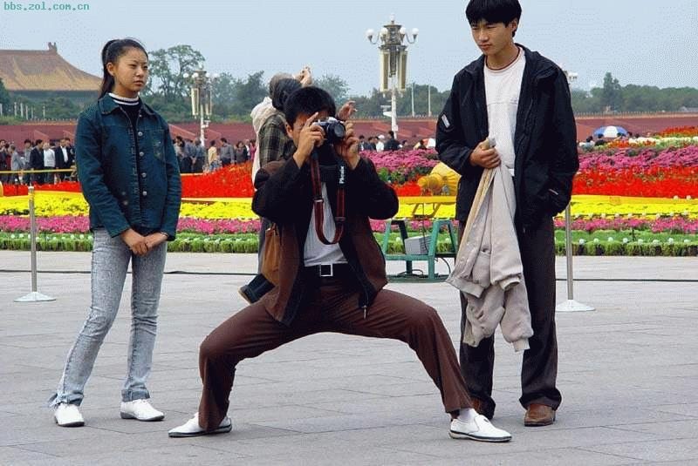
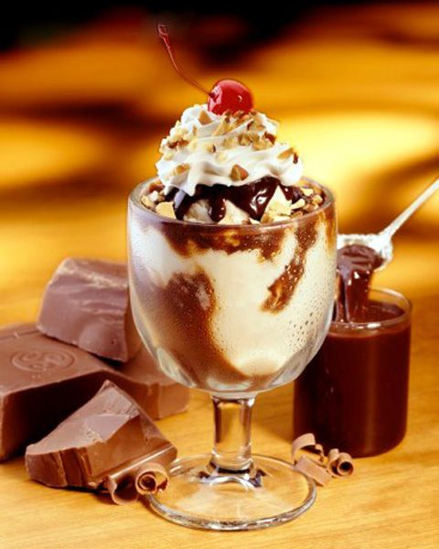
took photos
ate some ice cream

Slide 10
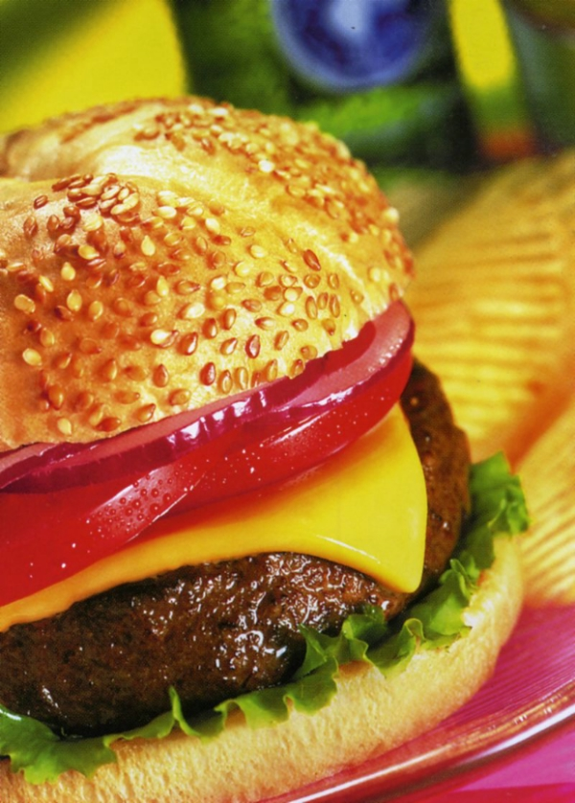
had a hamburger

Slide 11

Watch and Read

Slide 12

Objectives
To give students listening practice with the target language.
To let students role-play the conversation in 2d and learn the key words and phrases in it.

Slide 13


2a. Listen and check the questions
you hear.
___ What did the farmer say?
___ What did you see?
___ Did you learn anything?
___ Did you ask him any question?
___ Did you grow any apple?
___ Do they grow apples?
___ Did you eat them?
___ Were they good?
√
√
√
√

Slide 14
2b. Listen again. Circle “T” for true
or “F” for false.
1. The farmer showed Carol around the farm. T F
2. Carol learned a lot about farming. T F
3. The farmers grow strawberries from
December to June. T F
4. The farmers don’t grow apples. T F
5. Carol picked some strawberries and
took them home. T F

Slide 15
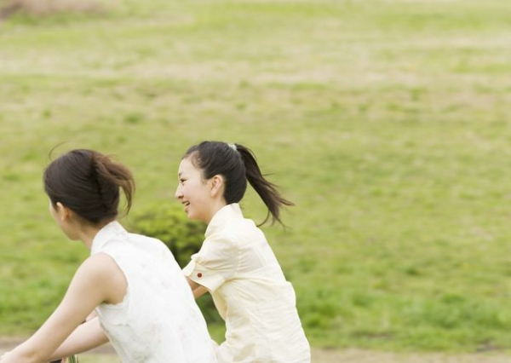
Speaking
2c. Ask and answer
questions about
Carol’s visit to the farm.
What did
Carol do?
She picked
some
strawberries.

Slide 16
Practice
A: How was your school trip?
B: It was … (boring/interesting/good/great…)
A: What did you do on the school trip?
B: I went for a walk with my classmates.

Slide 17
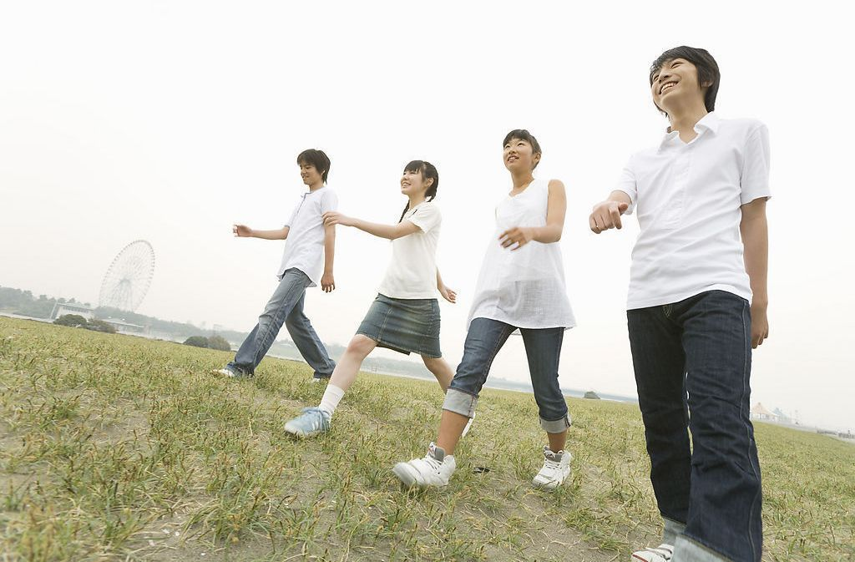
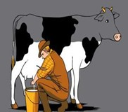
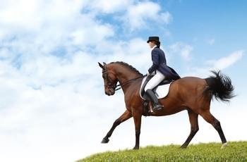
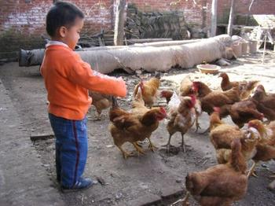
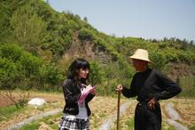
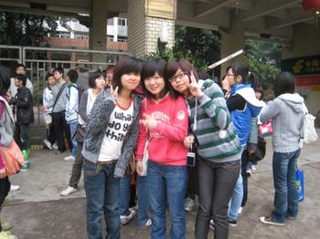
went for a walk
milked a cow
rode a horse
fed chickens
talked with a farmer
took some photos

Slide 18
2d. Role-play conversation.
How
Peter: Hi, Eric. _______ was your trip last week?
Eric: It was excellent. I _______ my grandparents in the countryside.
Peter: Oh, nice. What _______ you do?
Eric: I ___________ every day. And I fed the chickens with my grandpa. It was so much fun.
Peter: _____________. How was the weather there?
Eric: It was great and the air was so clean. I _________________ at night. They were so beautiful.
Peter: Lucky you.
visited
did
went fishing
Sounds good
watched the stars

Slide 19
Group work
Make a survey. Ask your partners what they did last week. Then give a reporter.
A: Hi, Carol. What did you do last
weekend?
B: I watched TV, and then I went fishing
with my father.
A: How was your last weekend?
B: It was boring.

Slide 20

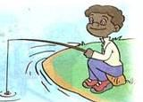
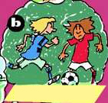
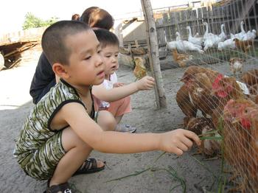

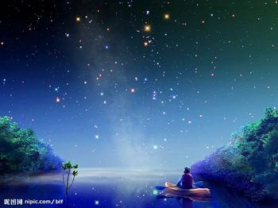
Names | Activities she/he did |  | How was his/ her weekend?/ feeling
Carol |  |  | boring/terrible/
Peter |  |  | busy/tired/bad
Eric |  |  | good/wonderful/ fantastic

Slide 21
In my group, Carol watched TV and went fishing. His weekend was boring. Peter…

Slide 22
Language points
1. I visited my grandparents in the countryside.
我去看望了乡下的爷爷奶奶。
a) visit 表示“拜访，看望，参观”，后面可以是宾语可以是人，也可以是地点名词。e.g.
visit my teacher = call on my teacher
visit your school = call at your school
b) in the countryside 在乡下
countryside在此处等同于country,都是“乡下，农村”之意，往往和冠词 “the” 搭配连用。e.g.
We spent a pleasant day in the country.

Slide 23
2. I fed the chickens with my grandpa.
“ feed … with …词组表示“用……喂……”,此时等于“feed … on …” ,短语中feed是及物动词,其后接人或动物名词作宾语。
e.g. A kid fed the monkey on/with a banana.
那个小孩用香蕉喂猴子。
短语feed on 中的feed为不及物动词，意思是“以……为食，靠……为生”，其主语主要用来指动物，也可用于指婴儿，其宾语通常是食物或饲料名词，此时等同于live on. e.g.
Cattle feed mostly on grass. 牛以草为主食。

Slide 24
3. Sounds good. 听起来不错！
此句子省略了主语 it, 全句子应该是 it sounds good. 此处sound为系动词，表示“听起来……”其后加形容词。同样用法的单词还有feel, taste, smell, look 等等，表示“摸，尝，闻，看……起来”。
e.g.:
This coat feels soft. 这件上衣摸起来很软。
The supper smells delicious. 晚饭闻起来很香。

Slide 25
4. Did you see any cows?
Yes, I did. I saw quite a lot.
quiet a lot 相当多+of+可数或不可数, 也可以单独使用。
quite a little 相当多+不可数名词
quite a few 相当多+可数名词

Slide 26
e.g. 我们喝了不少酒。
We drank quite a lot of wine.
我看到了相当多的奶牛。
I saw quite a lot of cows.
夏天我经常打网球。
I play tennis quite a lot in the summer.
不少学生迟到了。
Quite a few students were late.

Slide 27
5. Did Carol take any photos?
卡罗尔拍照片了吗？
take与photo, picture等词搭配时，表示“拍摄，摄影”。表示“拍摄某物或人”，就要在短语后面接介词“of”引入所拍摄的对象。
e.g. The girl likes to take photos of herself
with her cell phone.

Slide 28
6. It was so much fun.
fun表示“有趣的事情”，为不可数名词。
e.g. Look, Peter. The children are having
so much fun.
7. Lucky you! 你真幸运！
这是一句非正式口语，相当于You’re so lucky.
Lucky之后的人称还可以改为me, him。

Slide 29
Exercises
I. 用适当的词填空
1. How ___ your school trip? It was great.
2. How _____ you yesterday?
3. Today is Monday. Yesterday ___ Sunday.
4. What ___ you do the day before yesterday?
____ you ride a horse last week?
was
were
was
did
Did

Slide 30
6. ____ he see any cows on the farm? Yes, he did.
7. Did he milk a cow on the farm? No, he ______.
8. Were the strawberries good? Yes, they _______.
9. Did you see any cows?
Yes, I did. I ___ quite a lot.
10. I ___ the chickens last week.
Did
didn’t
were
saw
fed

Slide 31
II. 汉译英
1. 他上周在农场骑马。
2. 他上个月爬山了。
3. 他一小时前喂了小鸡。
Last week he rode a horse on the farm.
He climbed the mountain last month.
He fed chickens an hour ago.

Slide 32
4. 你昨天去了动物园吗？没有，我去了农场。
5. 你在农场看到一些奶牛吗？看到了，看到了相当多地奶牛。
Did you go to the zoo? No, I didn’t. I went to the farm.
Did you see any cows? Yes I did. I saw quite a lot.

Slide 33
III. 写出下列单词的过去式
talk milk
am /is are
go ride
feed take
do see
talked
was
went
fed
did
milked
were
rode
took
saw

Slide 34
IV. 译出下列短语
去散步
去购物
去钓鱼
挤奶牛
骑马
骑自行车
喂小鸡
和某人谈话
拍照
go for a walk
go shopping
go fishing
milk a cow
ride a horse
ride a bike
feed chickens
talk with …
take photos

Slide 35
Review
课时重点回顾
go for a walk 散步
milk a cow 挤奶
take photos 拍照
show sb. around 带某人参观
go fishing 钓鱼
in the countryside 在乡村

Slide 36
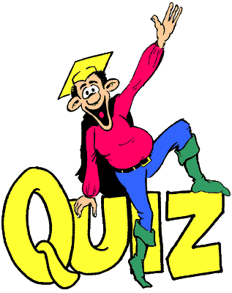

Slide 37
Ⅰ.根据句意，用括号内所给词的适当形式填空。
1. What did the ______ (farm) say?
2. Carol _____ (pick) some strawberries
and _____ (take) them home.
3. I ______ (visit) my grandparents in the
countryside.
4. I _______ (watch) the stars at night.
5. ____ (do) Carol take any photos?
farmer
picked
took
visited
watched
Did

Slide 38
Ⅱ.Translate and write them down.
1. 我奶奶经常在公园散步。
My grandma always goes for a walk in
the park.
2. 学习如何挤奶和种植水稻对农民来说
很重要。
It’s very important for farmers to learn
how to milk a cow or plant rice.
3. 他们带我们参观公司。
They show us around company.

Slide 39
4. 我租了一条船，为的是可以去钓鱼。
I hired a boat so that I could go fishing.
5. 他们在一起很有乐趣。
They have fun together.
6. 住在城里比住在乡下费钱。
Living in the city is more expensive than in
the countryside.

Slide 40
Ⅲ. 根据句意及首字母提示补全单词。
1. Tom doesn’t feel well, and he doesn’t want to eat a________.
2. We helped the farmers p______ strawberries on the farm.
3. My uncle g_____ flowers in the greenhouse.
4. She is an e________ singer.
5. We f____ our dogs on fresh meat.
nything
ick
rows
xcellent
eed

Slide 41
Homework
上个星期六学生们去西山进行了一次野餐, 请参考所给词语, 描述此次活动。go to West Hill, by bike, a short rest, after, at the foot of, sing, dance, climb, see, hear, take some photos, eat, happy

Slide 42
Thank You!

